Slide 1
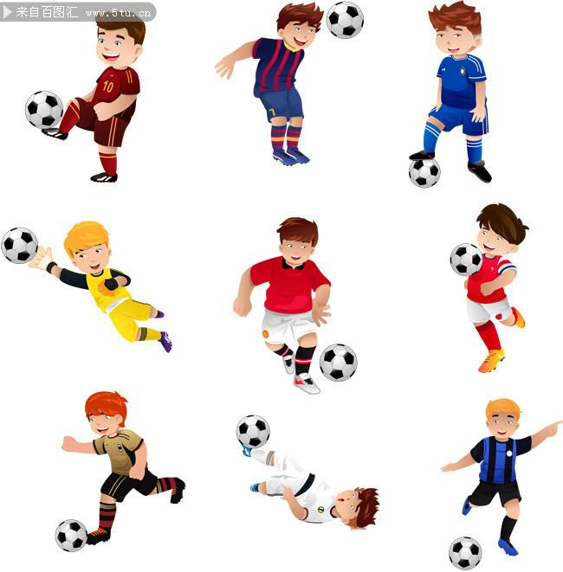
Unit 7
How Working Muscles May Boost
Brainpower
By Gretchen Reynolds

Slide 2
Upending the Cliché of muscleheads, scientists at the laboratory of Neuroscience at the National Institute on Aging recently set out to examine whether changes in muscles prompted by exercise might subsequently affect and improve the brain’s ability to think.
upend [ʌpˈendv.翻倒;倒放;使颠倒
E.g.
Their results upend some of our basic assumptions.
研究结果颠覆了我们的一些基本假设。
prompt [prɒmpt].促使;导致;激起;鼓励，
E.g.
His speech prompted an angry outburst from a man in the crowd.
他的讲话激起了人群中一男子的愤怒。

Slide 3
2. Lab animals and people generally performed better on tests of cognition after several weeks of exercise training, and studies have shown that over time, running and other types of endurance exercise increase the number of neurons in portions of the brain devoted to memory and learning. But the mechanisms that underlie this process remain fairly mysterious. Do they start within the brain itself? Or do messages arrive from elsewhere in the body to jump-start the process?
翻译划线部分： 研究显示， 经过一段时间以后， 跑步以及其它形式的耐力训练提高了在大脑中主管记忆和学习的那些部分的神经元的数目。
Difference between part & portion
part 适用范围最广，泛指任何整体或单一事物的一部分，不含大小概念。作可数名词或不可数名词。a part 常暗示分开的部分；part 常暗示整体中的部分。 portion 指整体的一部分时，并不暗示整体具有紧密，不可分割的特点。有时指分配的数额或数量，尤指饭馆食物一份或一客的限额。作可数名词。
portion偏向份额，份，把总的分成了几份（不一定是等分）后每份的份额的意思，所以感觉有占一定比例的意思 part没有这个意思。

Slide 4
3. The researchers were especially interested in the possibility that the action starts outside the brain-and specifically in the muscles. “We wondered whether peripheral triggers might be activating the cellular or molecular cascades in the brain that led to improvements in cognitions,” says Henriette van Praag, the investigator at the National Institute on Aging who led the study.
Cell 细胞
cellular [ˈseljələ(r)]细胞的
molecule [ˈmɒlɪkjuːl] n. 分子;
molecular [məˈlekjələ(r)] adj.分子的

Slide 5
4. Muscles are, of course, greatly influenced by exercise. Muscle cells respond to exercise by pumping out a variety of substances that result in larger, stronger muscles. Some of those compounds might be entering the bloodstream and traveling to the brain, Dr. van Praag says.
pump out 抽出

Slide 6
sedentary
畅通词汇
英 ['sedntri] 美 ['sednteri]
adj. 久坐的；固定不动的
5. The problem is that exercise is such a complicated physiological stimulus that it’s difficult to isolate which compounds are involved and what their effects might be. So she and her colleagues decided to study “fake” exercise instead, using two specialized drugs that had been tested several years ago by scientists at the Salk Institute in San Diego. The drugs had been shown to induce the same kinds of changes in sedentary animals’ muscles that exercise would cause, so that even though the mice didn’t exercise, they physiologically responded as if they had.
Physiological 生理的 Psychological 心理的
induce [ɪn'djuːs] vt. 引起；促使；劝服；引诱
Difference between induce & promt:
:induce含有引导的意思,不见得有坏的动机. prompt是常用词,指对一件可能发生的事情起导火线作用,重点在最终促使事情的发生。
sedentary ['sedntriadj. 久坐的；固定不动的requiring sitting or little activity
E.g.
People in sedentary jobs need to take exercise. 工作上要久坐的人需要做运动。

Slide 7
6. One of the drugs that they used, known as AICAR, increases the muscles’ output of AMPK, an enzyme that affects cellular energy and metabolism. Regular endurance exercise, like running or cycling, increases the muscles’ production of this enzyme. In the Salk experiments, AICAR enabled untrained mice to run 44 percent farther during treadmill tests than other, sedentary animals that hadn’t received the drug.
enzyme n. 酶any of several complex proteins that are produced by cells and act as catalysts in specific biochemical reactions
metabolism n. 新陈代谢the organic processes (in a cell or organism) that are necessary for life

Slide 8
7. The second compound, GW1516, drug, also stimulates biochemical changes in muscle cells like thosea cholesterol caused by endurance exercise. But in the Salk studies, it had amplified endurance primarily in animals that also ran, allowing them to run farther than another set of running mice that didn’t get the drug. But it hadn’t done much muscle-wise for animals that remained sedentary.
cholesterol n. 胆固醇an animal sterol that is normally synthesized by the liver; the most abundant steroid in animal tissues
amplifyv. 扩大；详述；增强increase in size, volume or significance

Slide 9
8. By using these drugs in unexercised animals under well-controlled conditions, the scientist from the National Institute on Aging sought to determine whether changes in muscles then initiated changes in the brain.
Initiate v. 开始; 发起;
Examples of initiate in a Sentence
Verb Doctors have initiated a series of tests to determine the cause of the problem. The company initiated judicial proceedings against them.
Choose the Right Synonym for initiate 表示“开始”的近义词辨析
Verb
BEGIN, COMMENCE, START, INITIATE, INAUGURATE, USHER IN mean to take the first step in a course, process, or operation. BEGIN, START, and COMMENCE are often interchangeable. BEGIN, opposed to end, is the most general. begin a trip began dancing START, opposed to stop, applies especially to first actions, steps, or stages. the work started slowly COMMENCE can be more formal or bookish than BEGIN or START. commence firing commenced a conversation INITIATE implies taking a first step in a process or series that is to continue. initiated diplomatic contacts INAUGURATE suggests a beginning of some formality or notion of significance. the discovery of penicillin inaugurated a new era in medicine USHER IN is somewhat less weighty than INAUGURATE. ushered in a period of economic decline

Slide 10
9. And as it turned out, muscles did affect the mind. After a week of receiving either of the two drugs (and no exercising), the mice performed significantly better on testing of memory and learning than control animals that had simply remained quiet in their cages. The effects were especially pronounced for the animals taking AICAR.
control animals对照动物

Slide 11
10. The results, published in the journal Learning and Memory, showed that the drugged animals’ brains also contained far more new neurons in brain areas central to learning and memory than the brains of the control mice, an effect found by microscopic examination.
11. Because the two drugs “don’t cross the blood-brain barrier much, if at all” Dr. van Praag says, “we could be fairly confident that the changes we were seeing were related to an exercise-type reaction in the muscles” and not to brain responses to the drug.
if at all
Because the two drugs “don’t cross the blood-brain barrier much, if at all。
两种药物不太会跨越血脑屏障， 即使有那么一点， 也是微乎其微。
Drink in moderation, if at all. ——只要喝（酒），就要适量。
I don’t like you much, if at all. 我不太太喜欢你。 即使有， 也只是一点点。
This is not going to be very effective, if (it is effective) at all.这不会很有效，即使有那么点效果， 也微乎其微。

Slide 12
12. The message of this finding, she continues, is that “improvements in cognition” that followed exercise “would seem to involve changes throughout the body and not just in the brain.”
13. Although the exact process isn’t clear, Dr. van Praag speculates that some of the AMPK enzyme created during exercise enters the bloodstream and travels to the brain, setting off a series of new reactions there.
Speculate: v. 推测; 猜测;
setting off : a. 使爆炸，点燃； b, 引起;触发;激起 c. 出发，动身
A. Setting off firecrackers燃放鞭炮
B. The arrival of the charity van set off a minor riot as villagers scrambled for a share of the aid...
救济物资车的到来引发了小小的骚乱,村民们争先恐后地想抢到一份援助物资。
C. By now, a rocket will have set off on its35 million mile trip to Mars.
此刻，一枚火箭可能已经出发，踏上飞向火星的3,500万英里的旅程

Slide 13
Comprehension of the Text
1.What’s the purpose of the experiment introduced in the passage?
Answer: To examine whether changes in muscles prompted by exercise might subsequently affect and improve the brain’s ability to think. (paragraph 1)
2. What hypothesis did the researchers put forward before conducting the experiment?
Answer: The mechanism underlying the process that lab animals and people generally performed better on tests of cognition after several weeks of exercise training mainly starts outside the brain-and specifically in the muscles. (paragraph 2&3)
3. Why did the researchers choose to study “fake” exercises?
Answer: The problem is that exercise is such a complicated physiological stimulus that it’s difficult to isolate which compounds are involved and what their effects might be. So she and her colleagues decided to study “fake” exercise instead, using two specialized drugs that had been shown to induce the same kinds of changes in sedentary animals’ muscles that exercise would cause, so that even though the mice didn’t exercise, they physiologically responded as if they had.
4. What was the finding of the experiment? Did the finding confirm their previous hypothesis?
Answer: The finding of the experiment is that muscles did affect the mind. After a week of receiving either of the two drugs (and no exercising), the mice performed significantly better on testing of memory and learning than control animals that had simply remained quiet in their cages. The effects were especially pronounced for the animals taking AICAR. (paragraph 9). Therefore this finding does confirm the previous hypothesis .
5. How can the scientists be sure that the changes they were seeing were related to an exercise-type reaction in the muscles instead of brain response to the drugs?
Answer: Because the two drugs “don’t cross the blood-brain barrier much, if at all. So we could be fairly confident that the changes we were seeing were related to an exercise-type reaction in the muscles” and not to brain responses to the drug.

Slide 14

Thanks for watching!

